Slide 1

South Carolina
Aeronautics Commission
Budget Request FY2020-2021

Slide 2
1. List of Key Officials in Attendance
2. Organization and FTE Breakdown
3. Accountability Report Summary
4. Budget Request Summary
5. Budget Request
6. Proviso Request Summary
7. Carry Forward
8. Other Information
South Carolina Aeronautics Commission
Budget Request FY2020-2021
Table of Contents

Slide 3
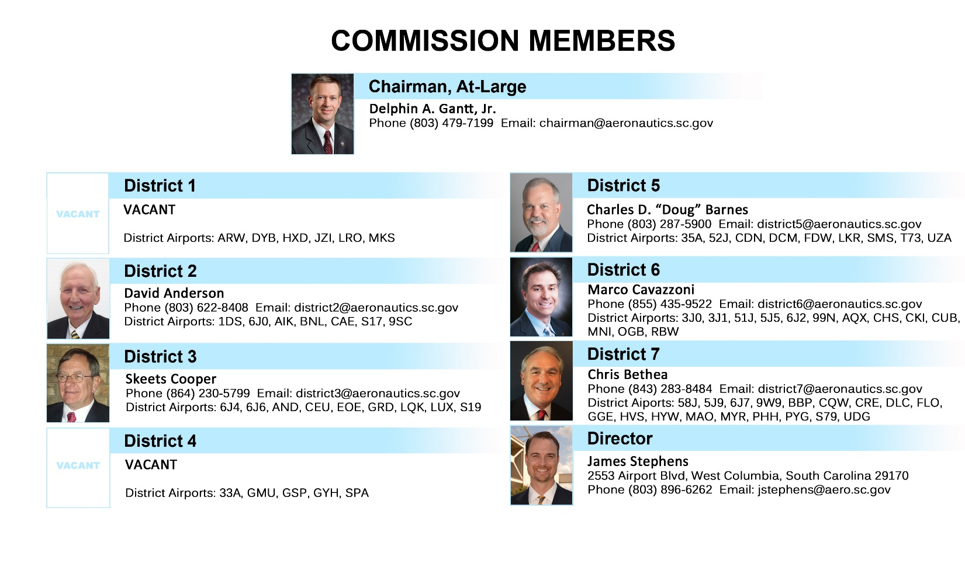
Key Officials in Attendance
Agency Attendees:
James Stephens
Executive Director
Melody Mikell
Finance Director
Ericka Thomas
Office Manager

Slide 4
ORGANIZATION and FTE BREAKDOWN
14 FTE’s Currently Authorized
Filled, 3 Vacant, 4 Contract/Temporary
No Expected Change in Personnel
.

Slide 5
Annual Accountability Report Summary
FY2018-2019
Aeronautics has approved and financially participated in twenty-six new state funded grants totaling $1,261,044.
Aeronautics was the recipient of a new federal grant from the FAA for Automated Weather Observation Station (AWOS) upgrades at the following airports: Aiken Regional, Allendale County, Barnwell County, Beaufort County, Berkeley County, Camden, Charleston Executive, Conway/Horry County, Fairfield County, Georgetown County, Donaldson Center, Hartsville Regional, Hilton Head Island, Lancaster County, Laurens County, Low Country Regional, Marion County, Marlboro County, Mt. Pleasant Regional, Newberry County, Pickens County, Santee Cooper Regional, Spartanburg Downtown, Summerville, Sumter, Union County, and Williamsburg County airports.
Aeronautics published and distributed the 2019 Aeronautical Chart and Airport Directory.
Aeronautics continues to inspect public use airports to ensure they maintain state and federal standards.
Aeronautics continues to provide cost effective, safe air transportation.
Aeronautics continues to serve on the SC-EMD Air Operations Branch, and assisted with post hurricane emergency response activities.
Aeronautics continues to support aviation education by promoting and financially participating in education grants for STEM based aviation education training and flight simulation training. This educational outreach has provided opportunities to thousands of students in SC, and makes students aware of the career paths that are available to them in aviation/aerospace here in SC.

Slide 6
Budget Request Summary
FY2020-2021
Recurring Appropriations:
  $2,500,000 for airport improvements
  $250,000 for aircraft maintenance and acquisitions
Non-Recurring Appropriations:
  $350,000 for Window Frame replacement
  $400,000 for Roofing and Coatings

Slide 7
Budget Request: Recurring Appropriation
FY2020-2021
Aeronautics is requesting a $2,500,000 recurring appropriation with authorization.
  This appropriation will be used annually for airport improvement projects that have gone unfunded due to cash limitations, limitations of federal funding, and demonstrated need.
  South Carolina’s airports continue to be successful in their efforts to secure additional Federal funding. As a result, the need for State matching money has increased, causing the need for additional authorization to spend from the State Aviation Fund. All of the funding available in the State Aviation Fund is utilized for the State’s airport system, and are managed per SC Code Section 55-5-280(C), and as approved by the South Carolina Aeronautics Commission.
  In an effort to better serve our customers, maintain the safety of our airports, improve the functionality, maintain the economic benefits, and take advantage of as many Federal grant dollars as possible, the Division is requesting this appropriation or the direction of all Airline Property Taxes to be placed into the State Aviation Fund.
Aeronautics is requesting a $250,000 recurring appropriation for heavy aircraft maintenance that is coming related to engine overhauls, avionics installations, life-limited components, and future aircraft acquisitions.

Slide 8
Budget Request: Non-Recurring Appropriation
FY2020-2021
Aeronautics is requesting a one-time $350,000 appropriation for the completion of the Windows project at the division’s main offices.
  The first round of funding is being used to cover architectural design fees and the cost of the glass as initially requested.
  This second round of funding is due to the necessary replacement of window frames whose conditions are not suitable for re-use as was previously planned.
Aeronautics is requesting a one-time $400,000 appropriation for the replacement of the Roof on the division’s main hangar, the Roof on the administrative building, and for a specialty coating on the Quonset hangar.

Slide 9
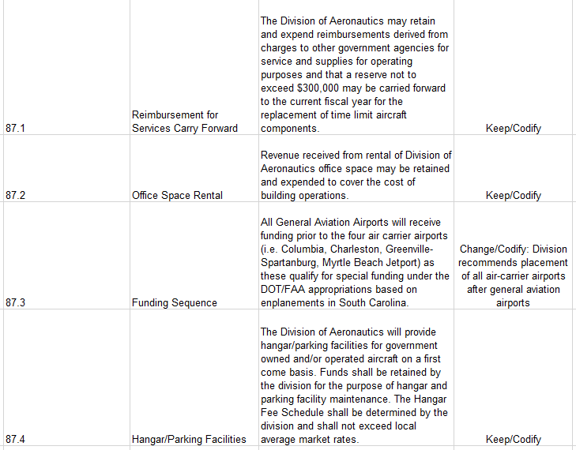
Aeronautics Proviso Request Summary
FY2020-2021

Slide 10
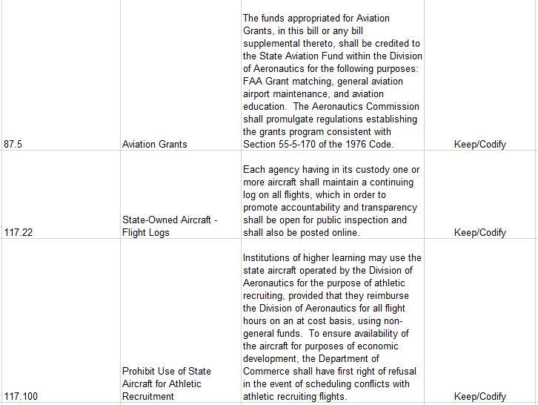
Aeronautics Provisos
Continued

Slide 11
Carry Forward into FY2019-2020
Fund | Fund Description | FY Ending Balance
1001 | General Fund | $202,858.41
3035 | Operating Revenue | $220,532.62
3166 | State Aviation Fund | $6,876,093.19
3958 | Sale of Assets | $20,645.98

Slide 12
Other Information
Title 55 – State Aviation Fund
SECTION 55-5-280
(A)(1) All monies received from licensing of airports, landing fields, or funds appropriated for aviation grants, the tax on aviation fuel, and fees for other licenses issued under this chapter must be paid into the State Treasury and credited to the fund known as the "State Aviation Fund".
(2) The fund also may receive gifts, grants, and federal funds and shall include earnings from investments of monies from the fund.
(3) A fund balance at the close of the fiscal year shall not lapse but must be carried forward to the next fiscal year.
(4) The revenue credited to the State Aviation Fund pursuant to this subsection must be used solely as provided in subsection (C).
(B) In any fiscal year in which the tax levied by the State pursuant to Section 12-37-2410, et seq., exceeds two and one-half million dollars, the revenues in excess of two and one-half million dollars must be directed to the State Aviation Fund; however, any revenue in excess of five million dollars must be credited in equal amounts to the general fund and the State Aviation Fund.
(C) The State Aviation Fund must be used solely for:
(1) maintenance and repairs of the division's aircraft; or
(2) maintenance, rehabilitation, and capital improvements to public use airports, which may include use as matching funds for FAA Airport Improvement Grants, provided that those airports receiving grants meet the requirements set forth by the division.
(3) The State Aviation Fund must not be used for operating expenses of the division.
(D) The division may promulgate regulations governing the eligibility requirements and procedures for disbursements from the State Aviation Fund.
HISTORY: 1962 Code § 2-75; 1952 Code § 2-75; 1942 Code § 7112-20; 1935 (39) 447; 1937 (40) 595; 1938 (40) 1835; 1993 Act No. 181, § 1289, eff July 1, 1993; 2005 Act No. 11, § 1.F, eff upon approval (became law without the Governor's signature on January 13, 2005); 2012 Act No. 270, § 3, eff June 18, 2012; 2016 Act No. 239 (H.4577), § 1, eff June 5, 2016.

Slide 13
Other Information
Aircraft (Airline) Property Tax
TO AMEND SECTION 12-37-2460 OF THE 1976 CODE, RELATING TO THE CREDITING OF AIRCRAFT PROPERTY TAXES, TO CREDIT THE PROCEEDS OF TAXES TO THE STATE AVIATION FUND; AND TO AMEND SECTION 55-5-280, RELATING TO THE STATE AVIATION FUND, TO MAKE A CONFORMING CHANGE.
Be it enacted by the General Assembly of the State of South Carolina:
SECTION 1. Section 12-37-2460 of the 1976 Code is amended to read:
"Section 12-37-2460. The proceeds collected under this article shall be paid into the general fund of the State Aviation Fund."
SECTION 2. Section 55-5-280 of the 1976 Code is amended to read:
"Section 55-5-280. (A)(1) All monies received from licensing of airports, landing fields, or funds appropriated for aviation grants, the tax on aviation fuel, and fees for other licenses issued under this chapter must be paid into the State Treasury and credited to the fund known as the 'State Aviation Fund'.
(2) The fund also may receive gifts, grants, and federal funds and shall include earnings from investments of monies from the fund.
(3) A fund balance at the close of the fiscal year shall not lapse but must be carried forward to the next fiscal year.
(4) The revenue credited to the State Aviation Fund pursuant to this subsection must be used solely as provided in subsection (C).
(B) In any fiscal year in which the tax levied by the State pursuant to Section 12-37-2410, et seq., exceeds two and one-half million dollars, the revenues in excess of two and one-half million dollars must be directed to the State Aviation Fund; however, any revenue in excess of five million dollars must be credited in equal amounts to the general fund and the State Aviation Fund.
(C) The State Aviation Fund must be used solely for:
(1) maintenance and repairs of the division's aircraft; or
(2) maintenance, rehabilitation, and capital improvements to public use airports, which may include use as matching funds for FAA Airport Improvement Grants, provided that those airports receiving grants meet the requirements set forth by the division.
(3) The State Aviation Fund must not be used for operating expenses of the division.
(D)(C) The division may promulgate regulations governing the eligibility requirements and procedures for disbursements from the State Aviation Fund."
SECTION 3. This act takes effect upon approval by the Governor and first applies to Fiscal Year 2018-
2019.

Slide 14
Other Information
State Aviation Fund Budget Projections
 | Expected Commitments for FY2020-2021
Expected New Grant Commitments | 2,700,000 *
Expected New Terminal Funding Requests | 500,000
State Sponsored Federal Match | 200,000
State Aviation Maintenance Projects | 1,500,000
State Aviation Administration Projects | 500,000
State Aviation Support Services | 450,000
TOTAL PROJECTED COMMITMENTS | 5,850,000
* New Commitments include the anticipated Federal FY2020 airport CIP’s, and State/Local projects. * Have multi-year life-cycles that can span up to four years. These funds are used as matching funds for Federal Aviation Administration grants, and Capital Improvements that may not be federally eligible.
 | Expected Commitments for FY2020-2021
Expected Program Commitments with recurring appropriation | 2,500,000*
New Commitments include grant and aid programming for the larger Commercial airports. Includes grant and aid programming at higher levels for the smaller General Aviation airports. May include grant programming for State Aviation System Plan identified projects. May include the funding of secondary pavements that are not federally eligible.

Slide 15
Other Information
State Aviation Fund Revenue
Total Annual Revenue (FY18/19): $5,659,500.43

